Slide 1

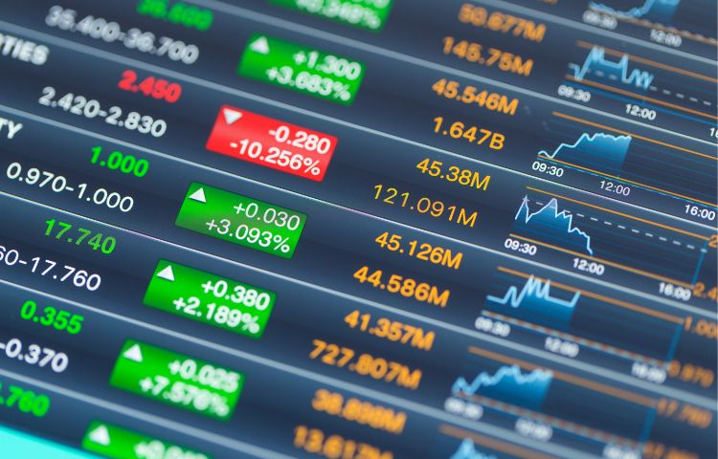
ACTIGNCE - (ACTIonable intelliGENCE)
By: Team – 4
Aneesh Antony Thomas
Amal Peediyakkal Shaji
Virat Ranpariya
Sreelekshmi Rajeshkumar
Neena Philip

Slide 2
Outline
Topics
Slide No.
Actignce Inroduction
Problem statement
Data source & Acquisition
Data processing flowchart
RSI & SMA
Feature Extraction
Training Model
LSTM model
LSTM Model with Visualization
LSTM Model with BUY,SELL,HOLD signals
Model Evaluation
Price prediction & Signaling
3
4
5
6
7-8
9
10
11
12
13
14
15

Slide 3
ACTIGNCE INTRODUCTION
1
Price prediction1
2
Signaling
1
in the stock market refers to the practice of forecasting the future price movements of a stock (or group of stocks) using various methods.
signals help people figure out whether they want to buy, sell, or hold a particular stock. However, no signal is foolproof—investors should still do their own research before making decisions.

Slide 4

Problem Statement
Investors/Traders are hesitant to participate in market due to fear of making wrong decisions.
Wrong decision leads to losses or less profit.

Slide 5
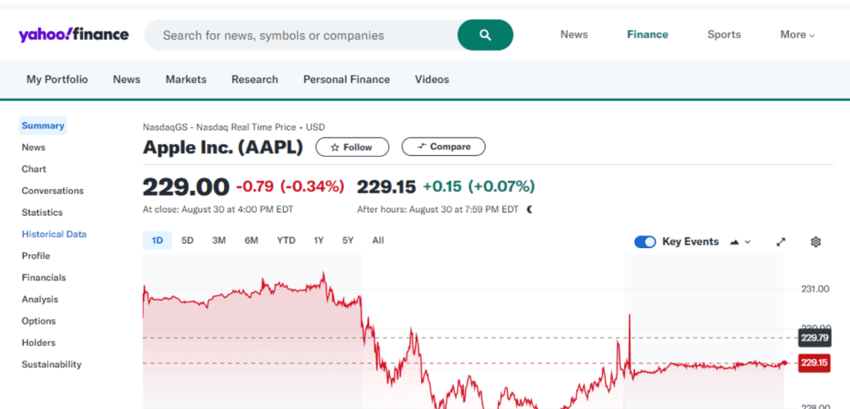
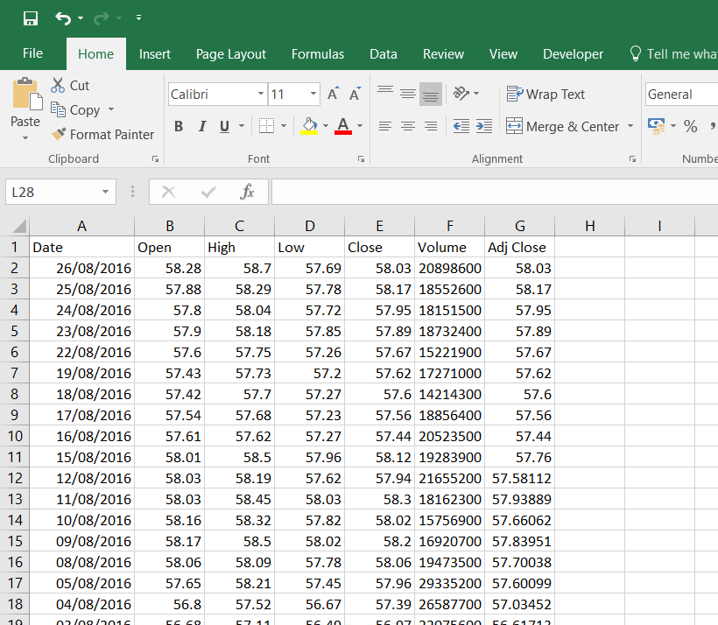
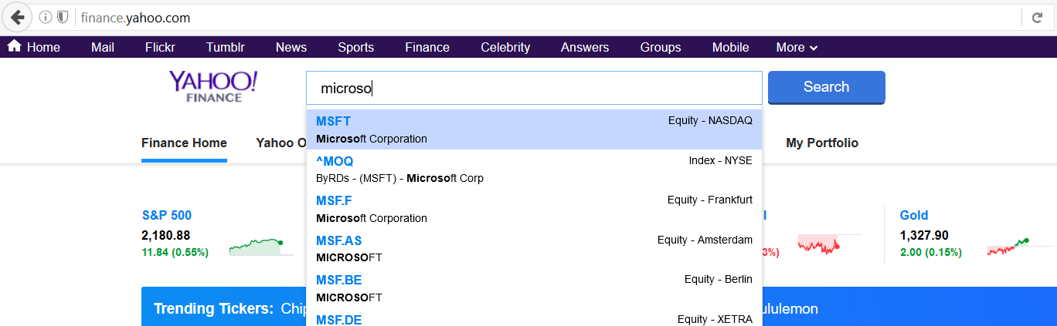

Data Source and Acquisition
Yahoo finance - real world data
Stock name
Dates
Opening and closing price
Day high and day low
Volume

Slide 6
Data processing flowchart
Data Collection
Data Cleaning
Feature Engineering
Scaling
Sequence Building
Train-Test Split
Ready for model training

Slide 7
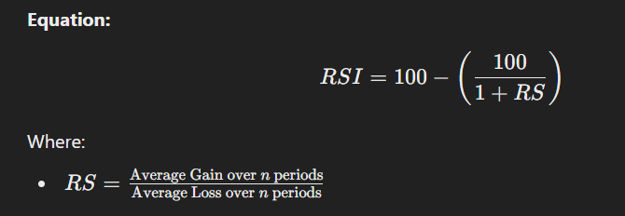
RSI (Relative Strength Index)
The Relative Strength Index (RSI) is a momentum oscillator that measures the speed and change of price movements. It oscillates between 0 and 100, helping identify overbought or oversold conditions.

Slide 8
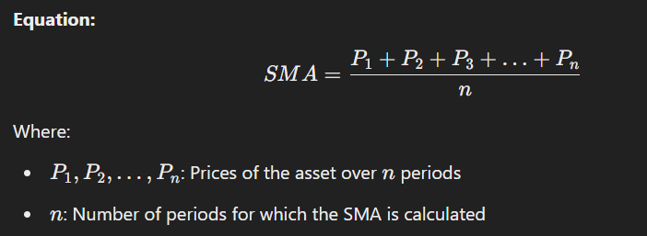
SMA(Simple Moving Average )
The Simple Moving Average (SMA) is a statistical measure that calculates the average of a set of prices over a specific number of periods. It smooths out price data to identify trends over time.

Slide 9
Feature Extraction
The process of transforming raw data into a set of meaningful, numerical attributes or features.
Input Dataset
Data Cleaning and Preprocessing
Feature Selection and Extraction
Model Training and Classification

Slide 10
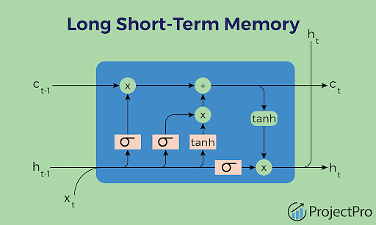
Training Model
A special type of Recurrent Neural Network (RNN).
Designed to handle sequential data and long-term dependencies.
LSTM can capture patterns in sequences over time, ideal for stock prediction.
Memory cells to store information.
Three gates: Input, Forget, Output.

Slide 11
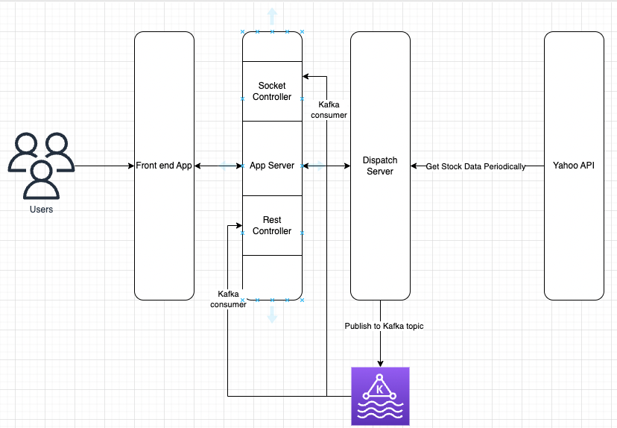
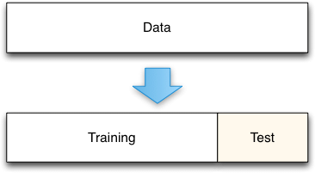
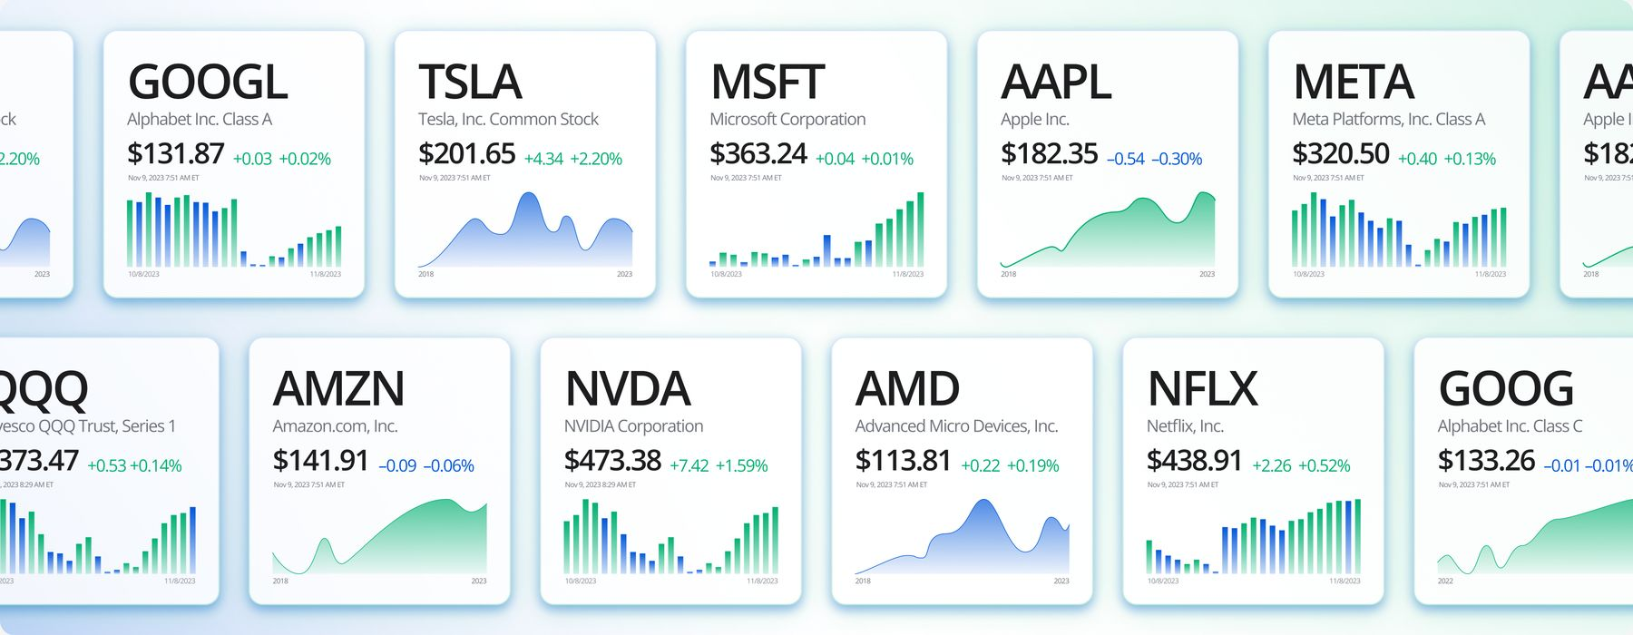
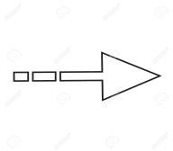
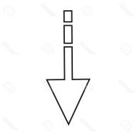

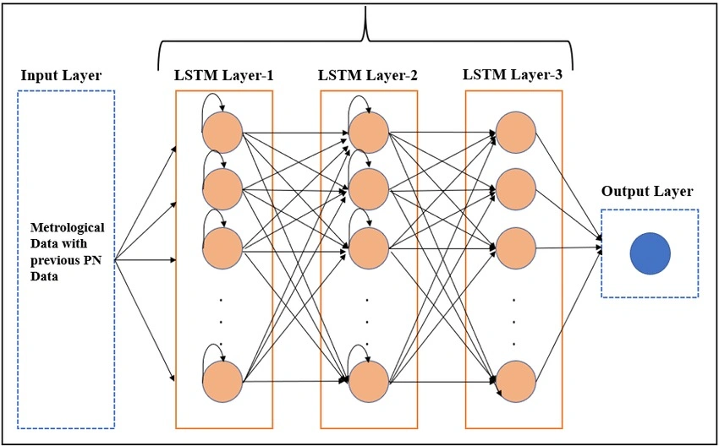
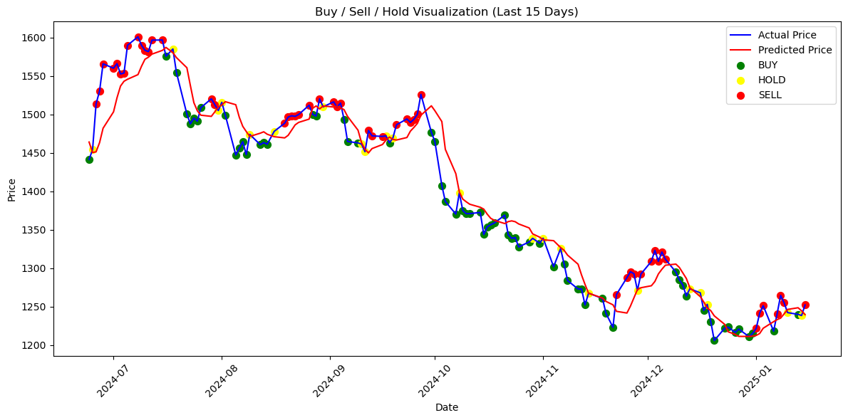
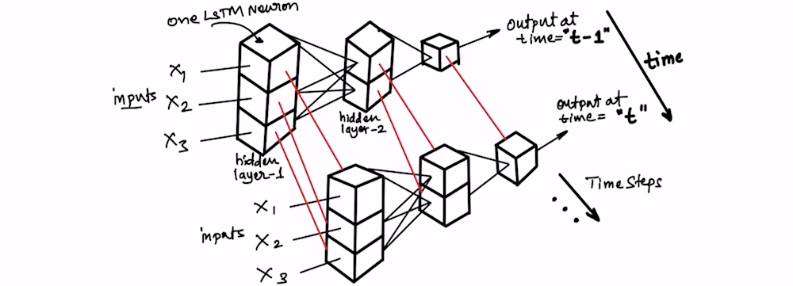
LSTM Model
Stock prices of past `n´ days from Yahoo Finance
Scaled Data
Training vs Testing Split
Actual vs Predicted Prices & Signals Overlay
Training Progress
Model Architecture

Slide 12
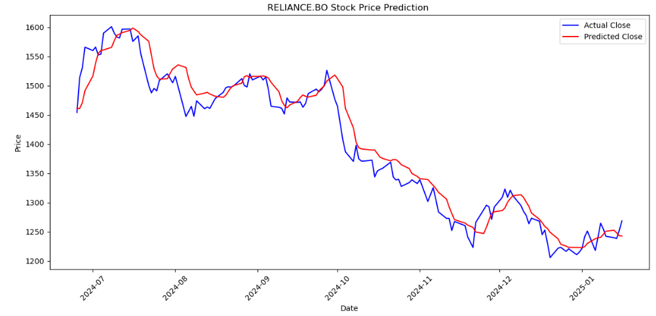
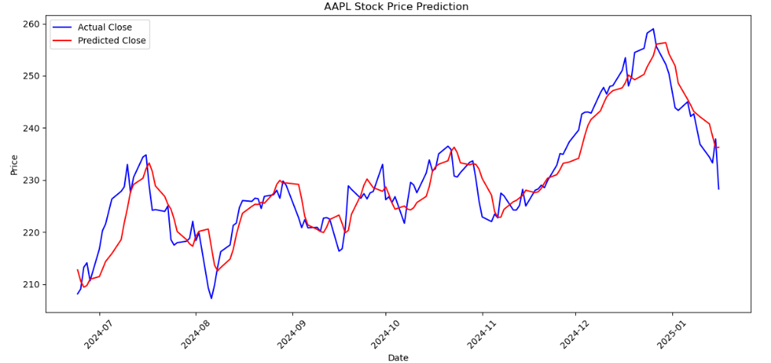
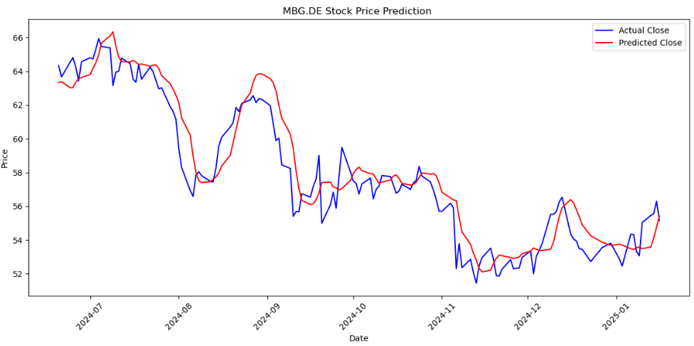
LSTM Model with visualization of actual and predicted values
Reliance
Apple
Mercedes-Benz

Slide 13
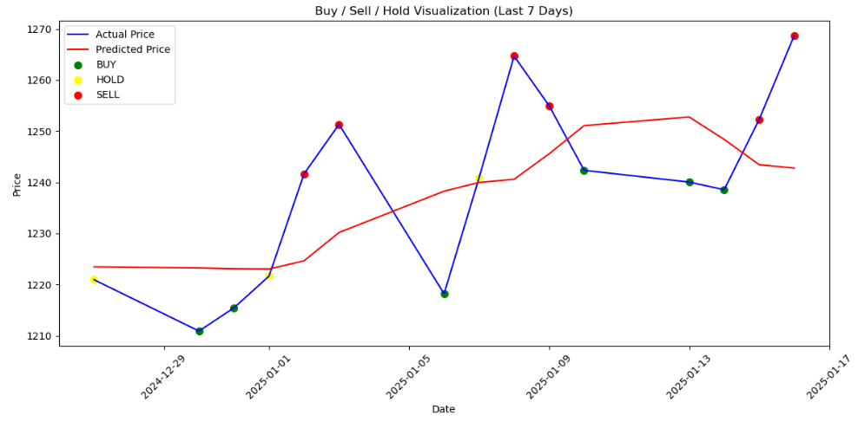
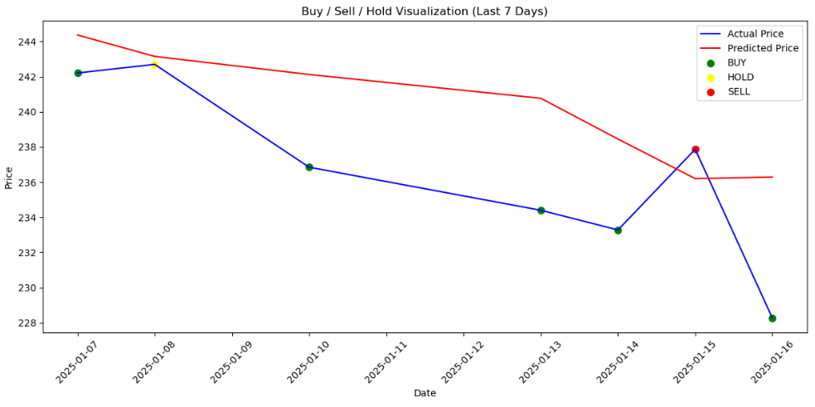
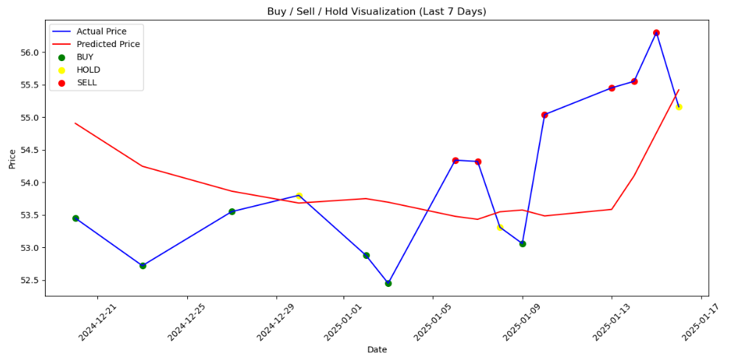
LSTM Model with visualization of Buy,Sell,Hold values
Apple
Mercedes-Benz
Reliance

Slide 14



Model Evaluation
We are using MSE & R² to evaluate performance of the model
Stock name : Reliance (RELIANCE:BO)
Stock name : Apple (AAPL)
Stock name : Mercedes-Benz (MBG:DE)

Slide 15
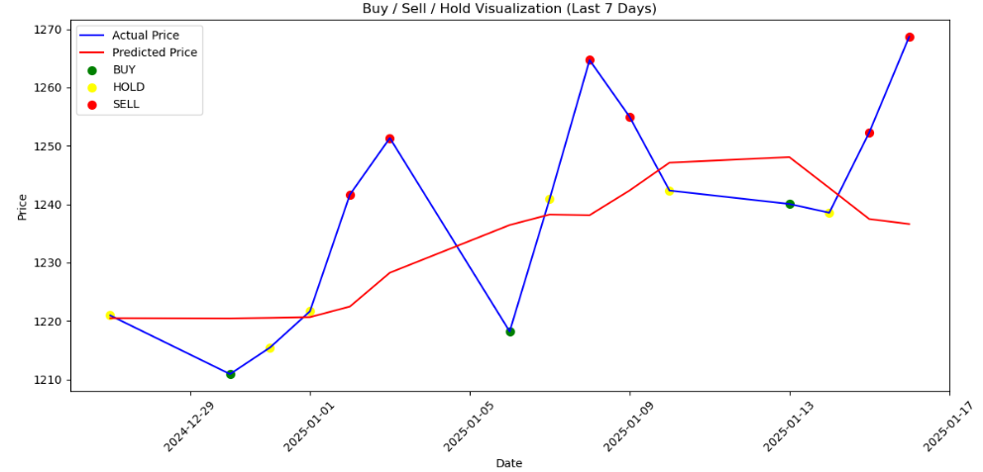
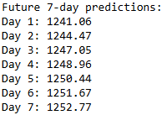
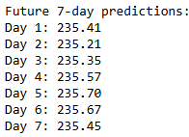
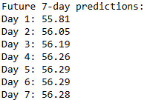
Price prediction & Signaling
Reliance
Apple
Mercedes-Benz

Slide 16
Thank You !
Thank You !

